Slide 1
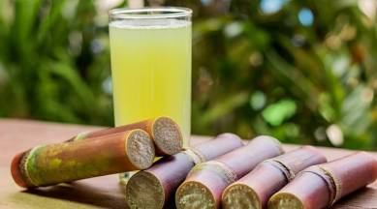
Maity JUICE PVT.LTD
PRESENTED BY : - SUBHAJIT MAITY
B.Voc (Food Processing,6TH Sem)
DEPARTMENT OF NUTRITION
GUIDED BY :-
DR. APURBA GIRI¹(HOD)
AYAN MONDAL² (ASSISTANT PROFESSOR)
DEPARTMENT OF NUTRITION

Slide 2
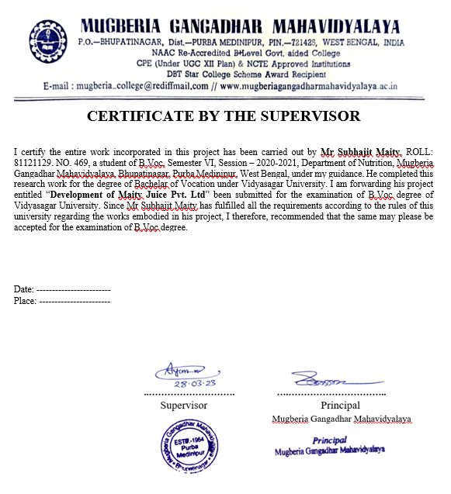
.
.

Slide 3
INTRODUCTION
Sugarcane is one of the most important commercial crops in the world.India is the second largest producer of sugarcane.In India, sugarcane is grown mainly for producing sweeteners such as sugar, jaggery and juice.Sugarcane juice, very useful in scanty urination, keeps the urinary flow clear and helps kidneys to perform their functions properly.most people are now preferred buying package sugarcane juice because of its ultimate purity and hygiene Sugarcane juice of 100 ml provides 40 Kcal of energy,

Slide 4
SUGARCANE JUICE MANUFUCTURING BUSINESS
REQUIREMENTS : -
INVESTMENT
LOCATION
BUSINESS RESEARCH
RAW METERIAL
MACHINES
AREA
MANPOWER
COUSTOMERS
LICENSES
PROFIT
MARKET STRATEGY

Slide 5


BUSINESS RESEARCH
DEMAND
SUPPLY
PRICE
QUANTITY
QUALITY

Slide 6

SELECTION OF PLANT LOCTION
Establishing a Small scale Industries of Sugarcane juice plant are ready a minimum 2000-5000 SQ FT . If possible, select the location that comes in close proximity to the marketing distribution areas. This way, it will become easier to reduce the overall transportation cost .

Slide 7
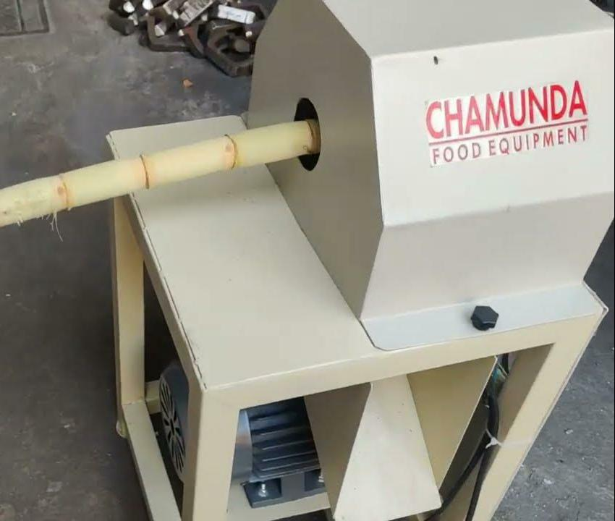
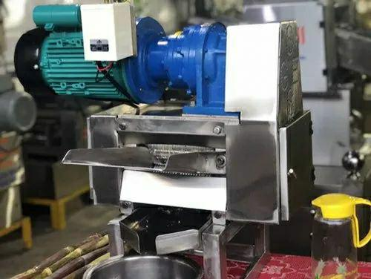
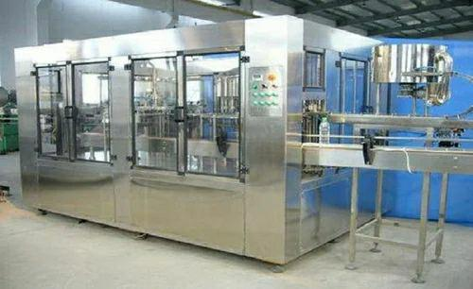
MACHINERY
Soaking Tank
Automatic Peeling Machine
Automatic Crusher Machine
Automatic Bottling Machine
Caping & sealing Machine
Compressor
Boiler

Slide 8

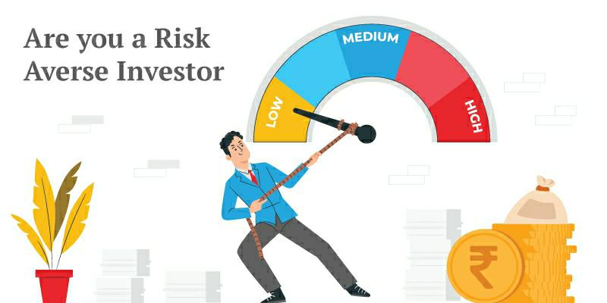

INVESTMENT
Capital 20-25 Lakhs

Slide 9
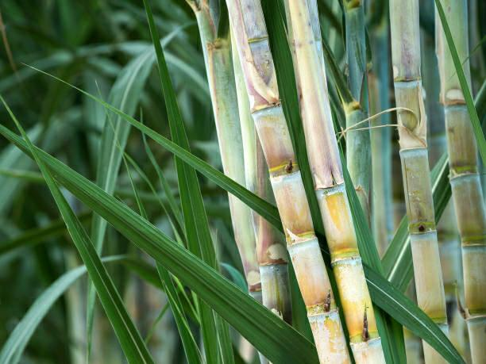
Raw Material
Sugarcane
Packaging Material (glass, plastic, tetra pack)
Preservatives
Flavour
Water

Slide 10

LICENSES
REGISTRATION OF BUSINESS
NOC PAPER(FORM STATE POLLUTION CONTROL,SOUND AND WATER)
TRADE LICENSES
GST(Goods & Service Tax)
FSSAI(Food Safety and Standards Authority of India)
SMALL SCALE INDUSTRY LICENSE
REGISTRATION FOR TRADEMARK

Slide 11
PROCESSING FLOW CHART
SELECTION OF GOOD SUGARCANE
SOAKING AND WASHING
PEELING AND CRUSHING
STORE IN(REFRIGERATOR)
JUICE EXTRACTION
OZONATION TREATMENT
FILTRATION
ADD FLAVOUR AND PRESERVATIVES
FILLING (BOTTLING)

Slide 12
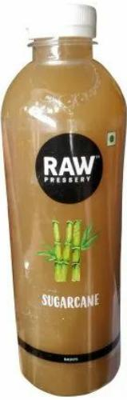
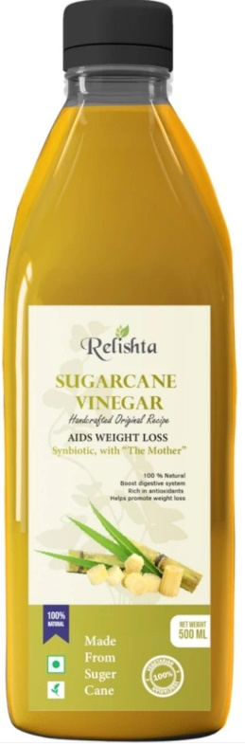
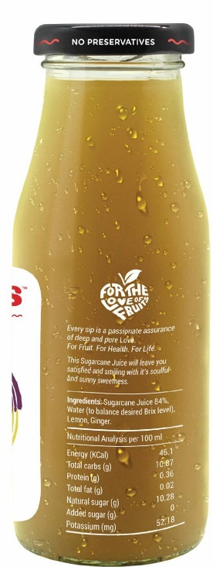
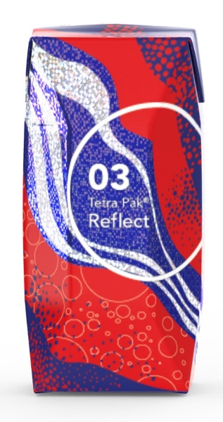
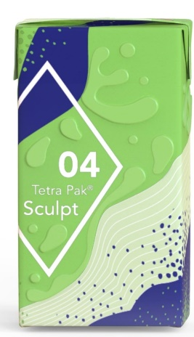
PACKAGING SIZES AND PRICE
SPECIAL OFFER
Combo discount on available online market
200 ml
49/-
500 ml
199/-
1 Liter
239/-
50 ml
10/-
100 ml
21/-

Slide 13


MARKETING STRATEGIES
Local Market Announcements
Advertising
Sales Promotion
Direct Marketing
Digital Marketing

Slide 14


TARGET COUSTOMERS
WHOLEESALERS
DISTRIBUTORS
RETAILORS
GENERAL STORES
ONLINE & OTHERS
ONLINE WEBSITE LINK Aap Ka Bazar,Big Basket.com,Alde Bazar, Amazon.in,Jio Mart, Snapdeal, Flipkart

Slide 15


PROFIT
REVENUE -12 LAKHS
EXPENSE -8 LAKHS
PROFIT-4 LAKHS
MANPOWER
8-10 STAFF
Depends on Production and Business Model

Slide 16
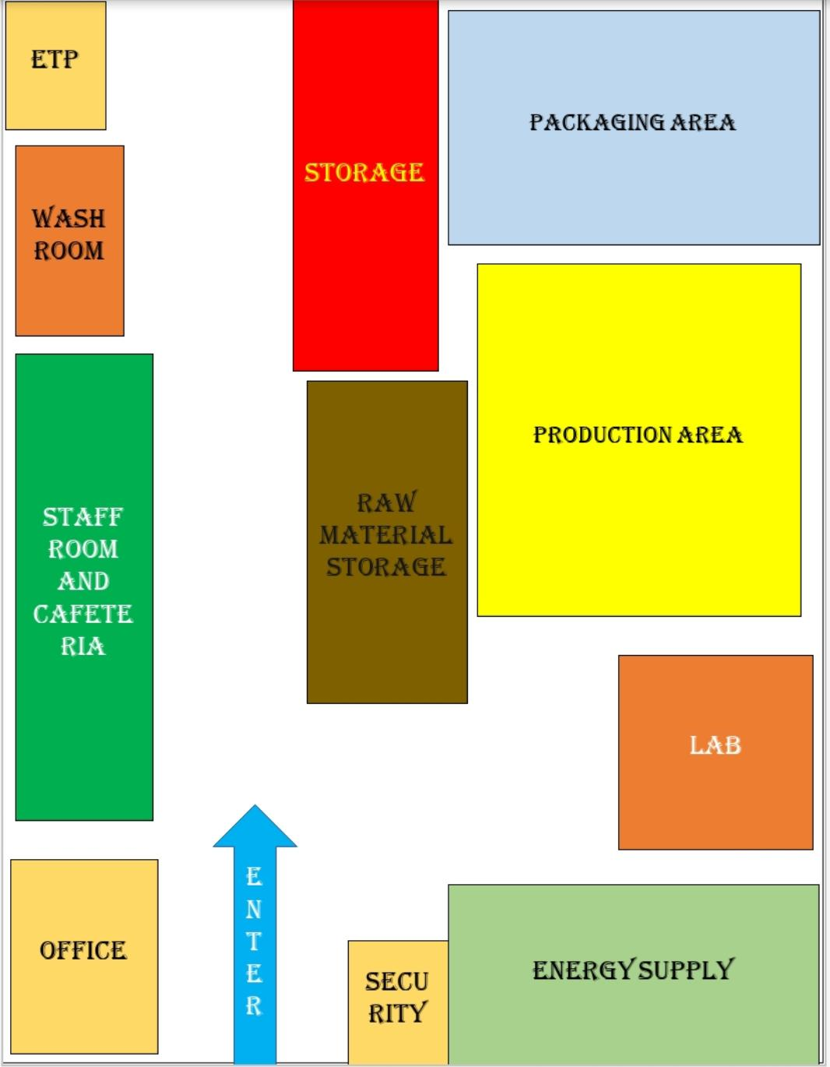
PLANT LAYOUT

Slide 17
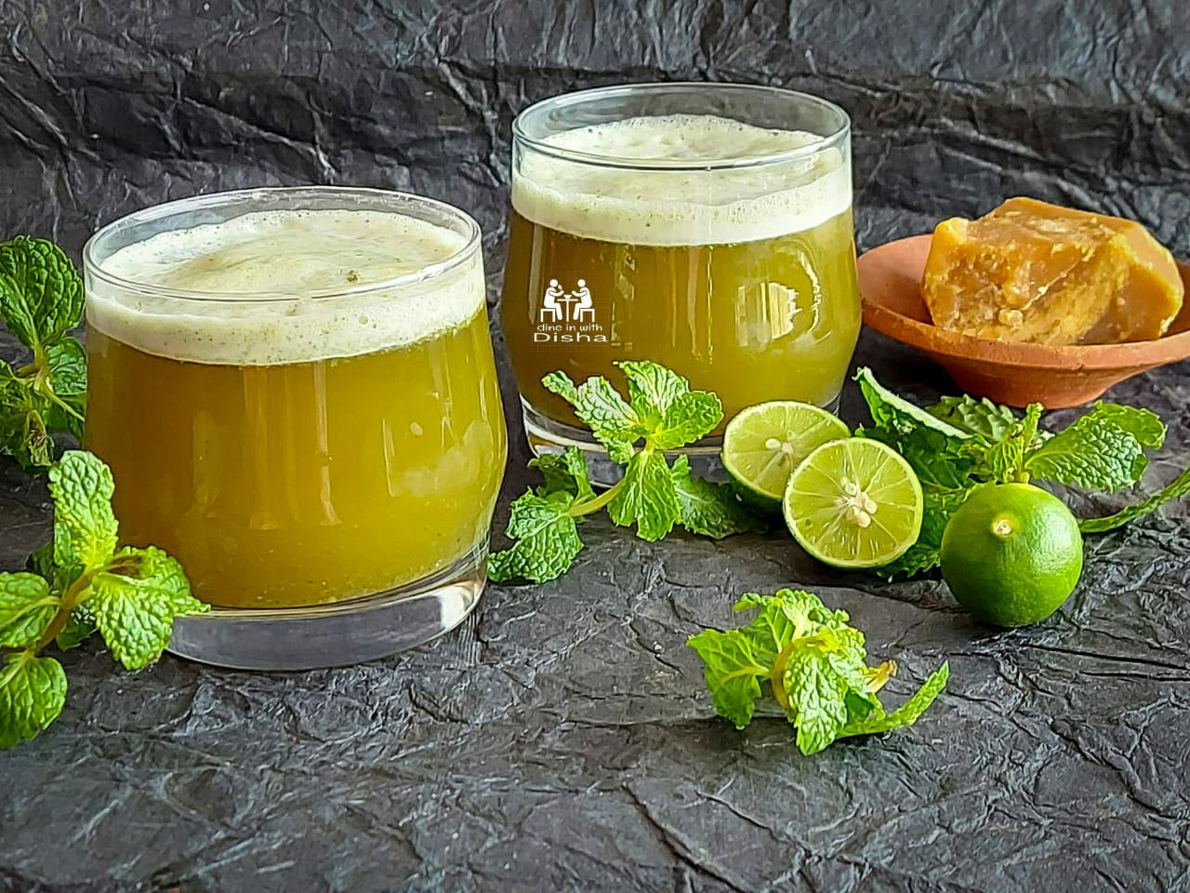
Thank you

